Slide 1
Graph Convolutional Networks lecture-7 Course on Machine Learning on Spatio-Temporal Graphs (Summer Term 22)
Prof. Dr. Holger Giese (holger.giese@hpi.uni-potsdam.de)
Christian Medeiros Adriano (christian.adriano@hpi.de) - “Chris”
Matthias Barkowsky (matthias.barkowsky@hpi.de )
Iqra Zafar (iqra.zafar@hpi.de)

Slide 2
Quick recap
Metrics
Classification
Random Walk
Node and Graphs Embeddings
Graph Structure Learning
Why do we need Graph Neural Networks?
We need a way to scale without having to make large random walks in the graph

Slide 3
Topics
Example from Industry
Graph Convolutional Networks (GCN)
Relational GCN
Mathematical background
Laplacian
Chebshev Approximation
Softmax

Slide 4
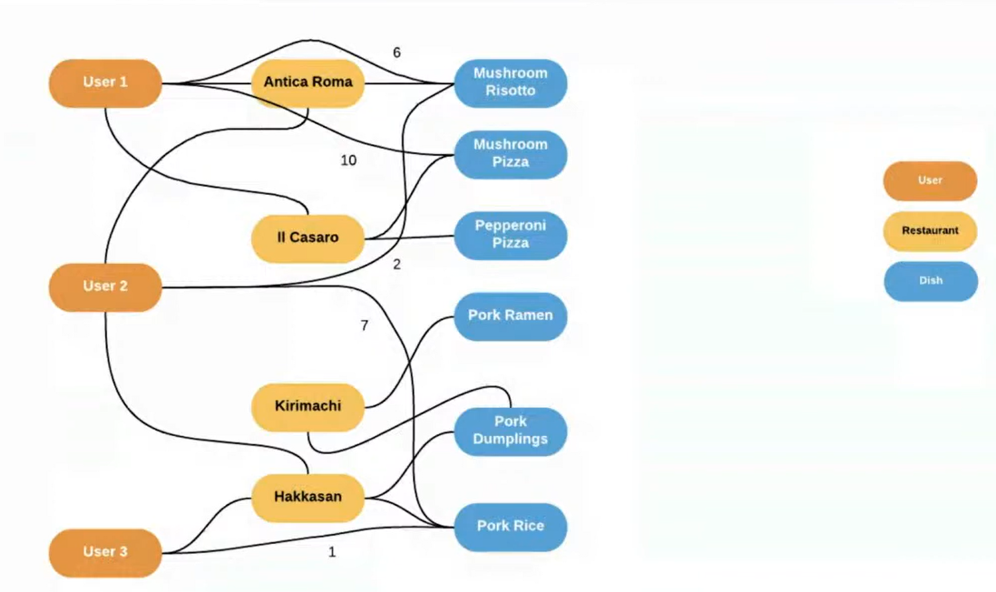
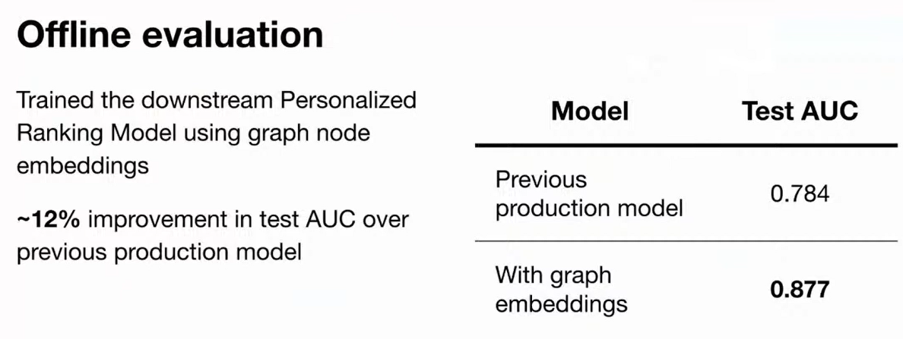
Motivation – Uber Eats
Ingredients
Dishes
Source: https://eng.uber.com/uber-eats-graph-learning/

Slide 5
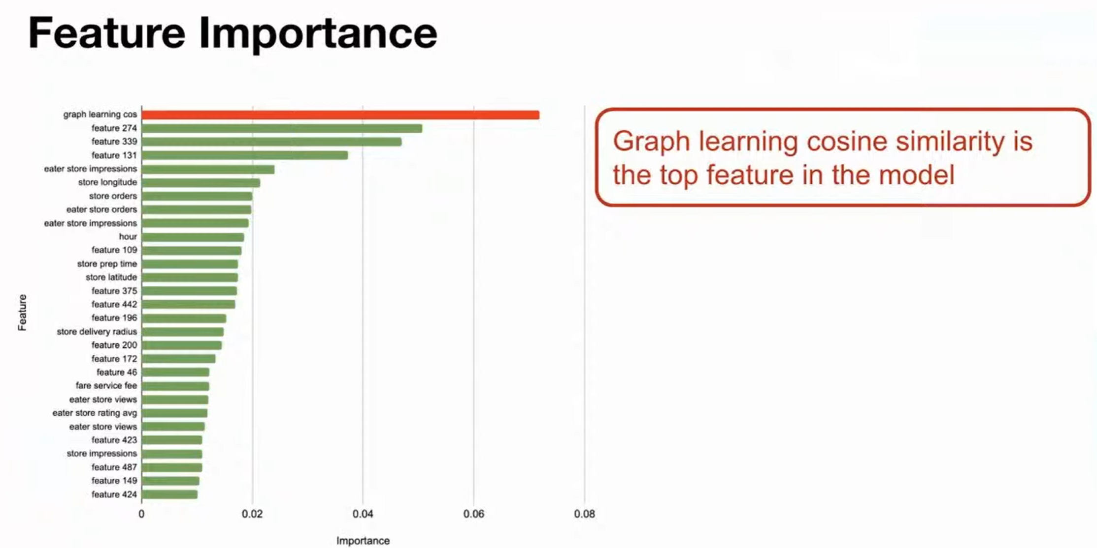
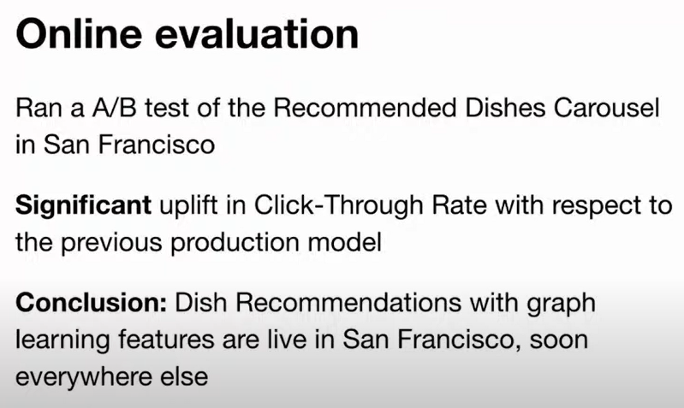
Outcomes

Slide 6
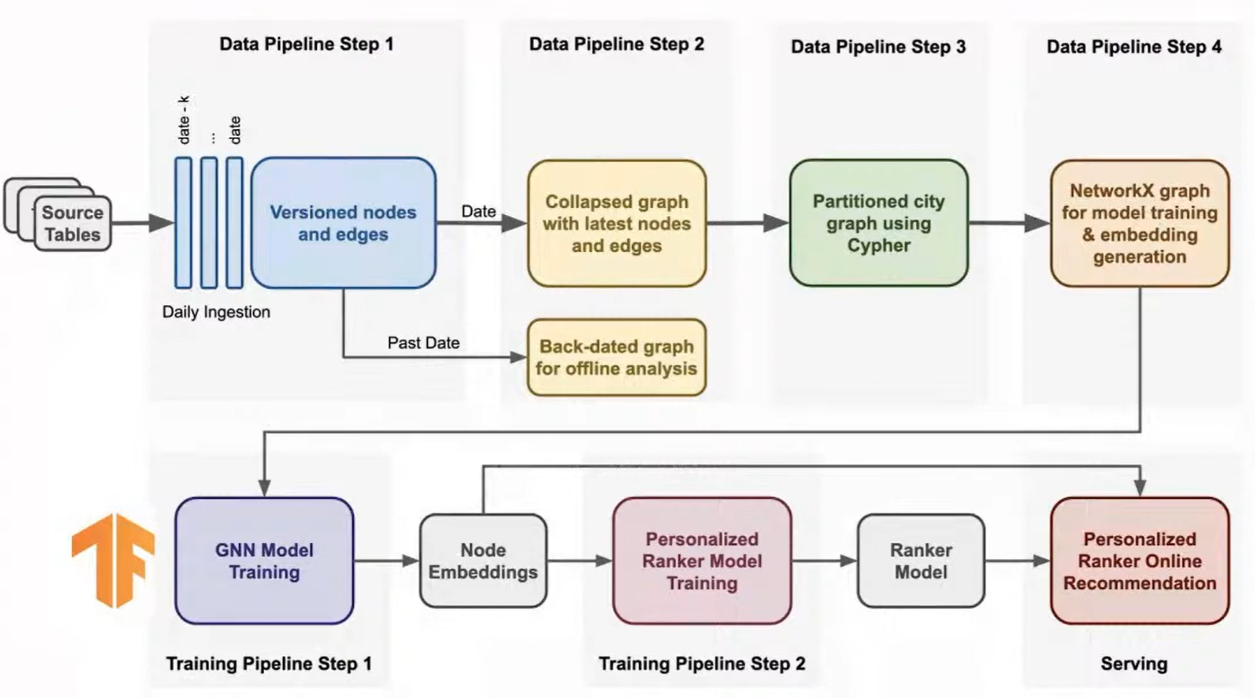
Pipeline
Source: https://eng.uber.com/uber-eats-graph-learning/

Slide 7
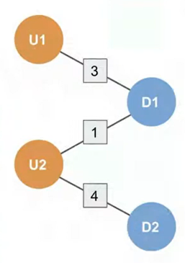
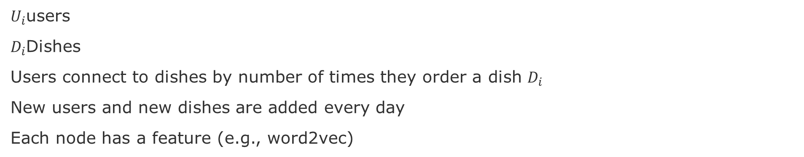
Bipartite Graph for Dish Recommendation
$U_{i}$users
$D_{i}$Dishes
Users connect to dishes by number of times they order a dish $D_{i}$
New users and new dishes are added every day
Each node has a feature (e.g., word2vec)
Source: https://eng.uber.com/uber-eats-graph-learning/

Slide 8
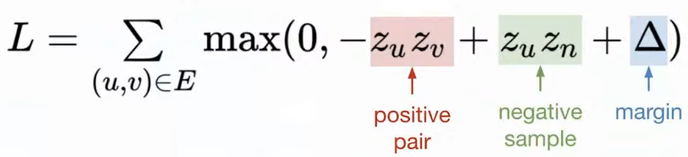
Margin Loss
For dish recommendation, the goal is to rank dishes for each user.
Goal is for the positive pair to surpass the negative pair
Source: https://eng.uber.com/uber-eats-graph-learning/

Slide 9
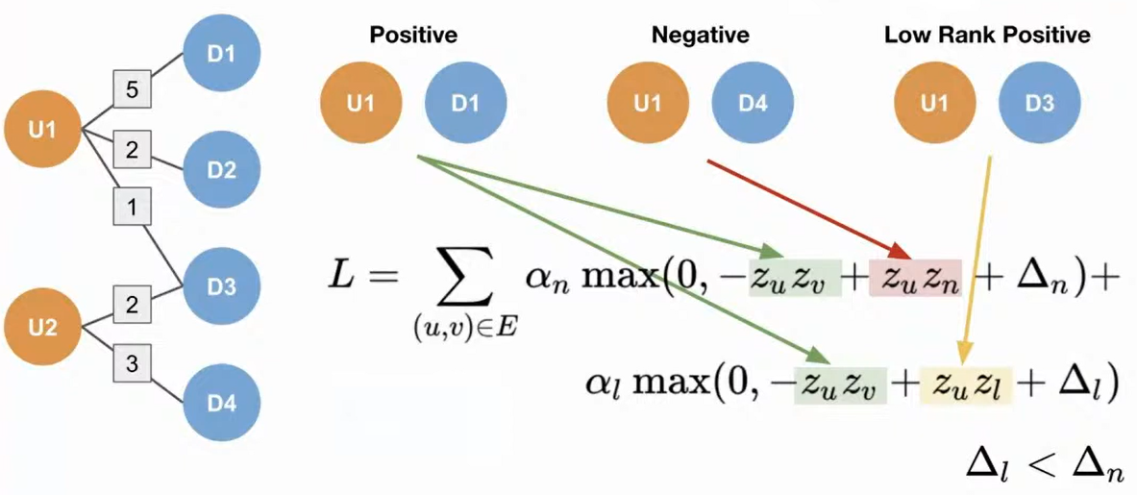
Loss with Low Rank Positives
Source: https://eng.uber.com/uber-eats-graph-learning/
Notes:
GNN Tutorials
https://uvadlc-notebooks.readthedocs.io/en/latest/tutorial_notebooks/tutorial7/GNN_overview.html
https://pytorch-geometric.readthedocs.io/en/latest/notes/create_gnn.html

Slide 10
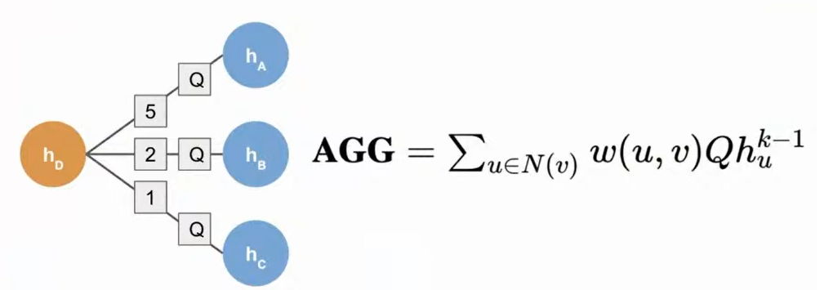
Weighted pool aggregation
Aggregate neighborhood based on the edge weights
Source: https://eng.uber.com/uber-eats-graph-learning/

Slide 11
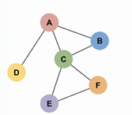
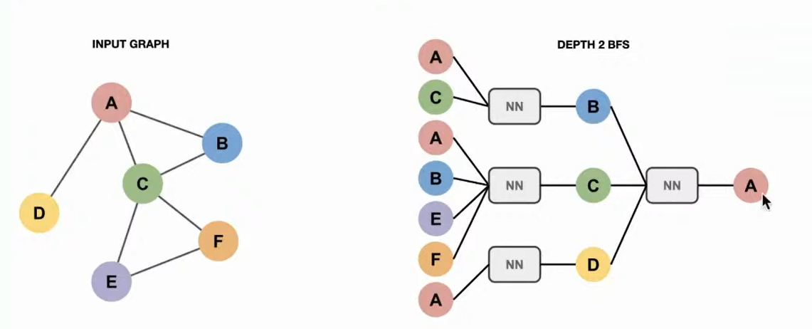
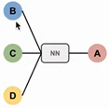
GNN key idea
Obtain a node representation by using a neural network to aggregate the information from the neighbors.
Output graph (depth =2 BFS)
Input graph
Do it recursively

Slide 12
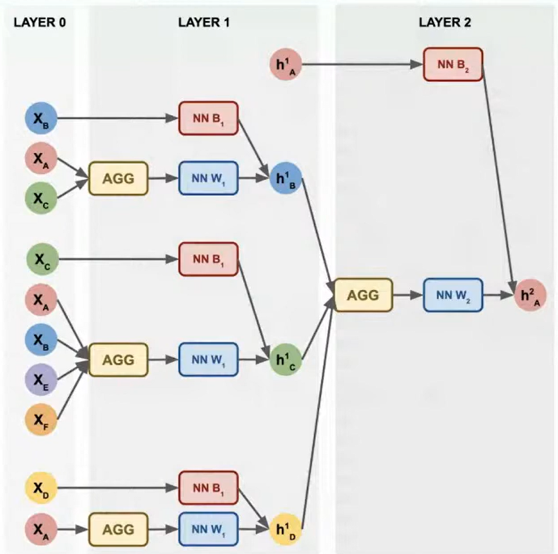
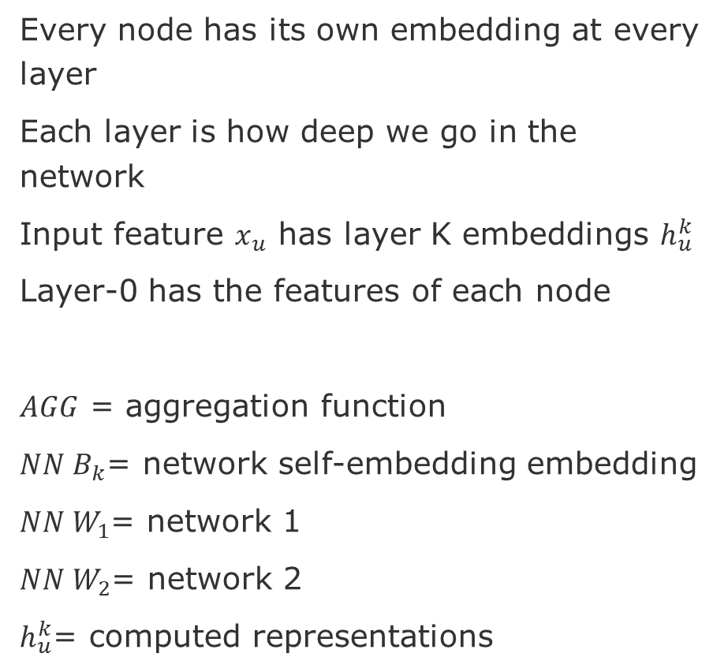
Solution for Recursion = Message Passing
Every node has its own embedding at every layer
Each layer is how deep we go in the network
Input feature $x_{u}$ has layer K embeddings $h_{u}^{k}$
Layer-0 has the features of each node
$AGG$ = aggregation function
$NN B_{k}$= network self-embedding embedding
$NN W_{1}$= network 1
$NN W_{2}$= network 2
$h_{u}^{k}$= computed representations

Slide 13
Tutorials - GNN
Tutorial 7: Graph Neural Networks
https://uvadlc-notebooks.readthedocs.io/en/latest/tutorial_notebooks/tutorial7/GNN_overview.html
Creating Message Passing Networks - PyTorch Geometric
https://pytorch-geometric.readthedocs.io/en/latest/notes/create_gnn.html
A Practical Tutorial on Graph Neural Networks, Ward et al, 2021
https://arxiv.org/pdf/2010.05234.pdf
Intro to Relational - Graph Convolutional Networks, Zack Jost, Short Video Lectures
https://www.youtube.com/watch?v=wJQQFUcHO5U&feature=emb_rel_end
Stanford CS224W: Machine Learning with Graphs
https://www.youtube.com/watch?v=JAB_plj2rbA&list=PLoROMvodv4rPLKxIpqhjhPgdQy7imNkDn

Slide 14
Scalability
Message Passing in GNN allows to scale because:
We do not depend on the number of nodes in graph, but the number of neurons that we decide to use to compute de embeddings at each layer.
We can limit the number of neurons because all these nodes share the same network at each layer
This is the scalability that we do not have in the standard methods like Node2Vec, for instance.

Slide 15
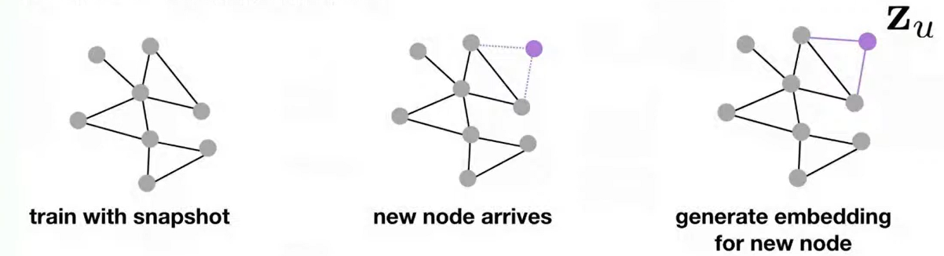
Inductive capability
In many applications new nodes are constantly added to the graph
This would require constant retraining to update the embeddings
While this is difficult to do with traditional methods, GNN allows to retrain on the part affected

Slide 16
Number of Layers in a GCN
Each node can have one or multiple dimensions (depends on the features that we choose)
In a 2-layer GCN, each node pull the information from their neighbors two times.
The number of GCN layer tells how far the signal could travel.
In a 2-layer GCN, the signal travels to a maximum to a two hops from the node.

Slide 17
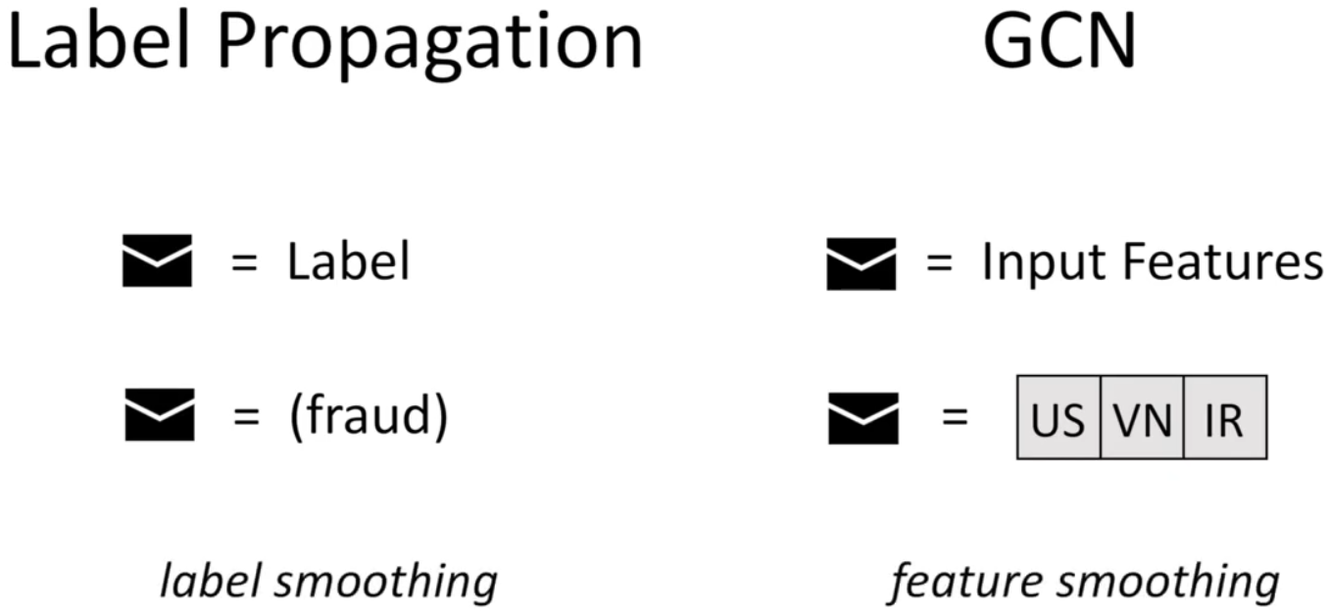
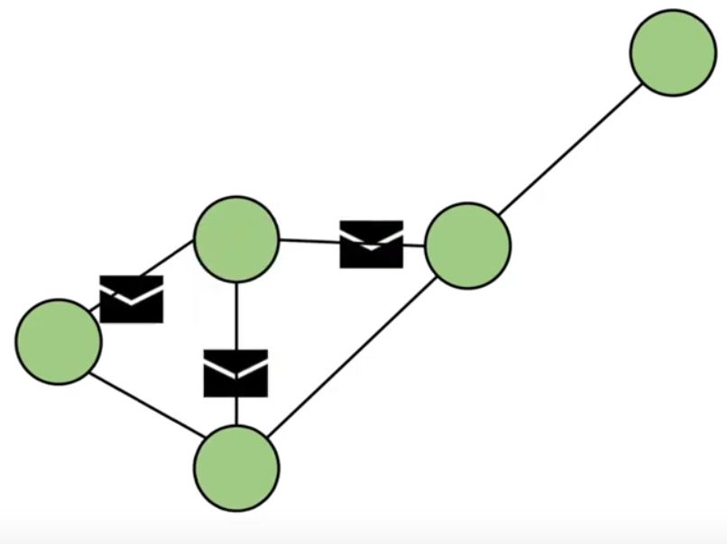
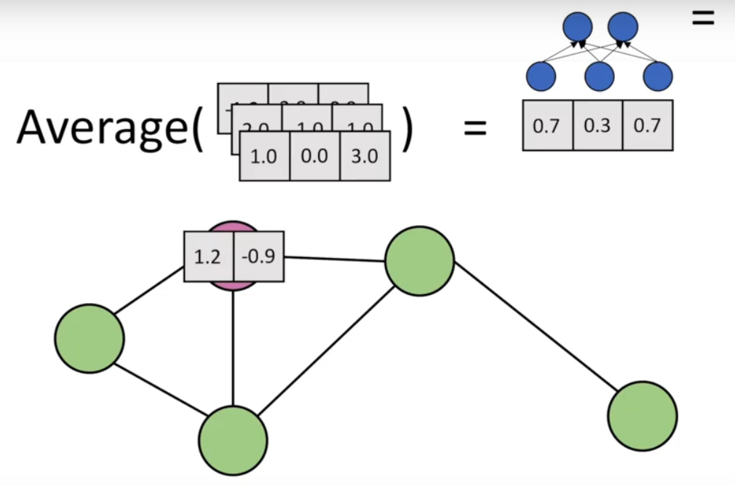
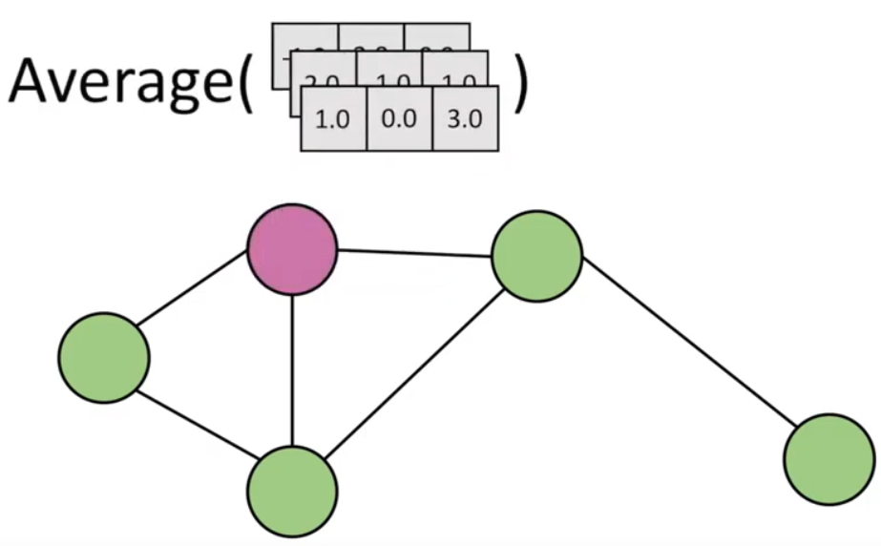
Steps
Message propagation
Feature aggregation
Enconding
source: Zack Jost, Short Lectures -Intro to Relational - Graph Convolutional Networks

Slide 18
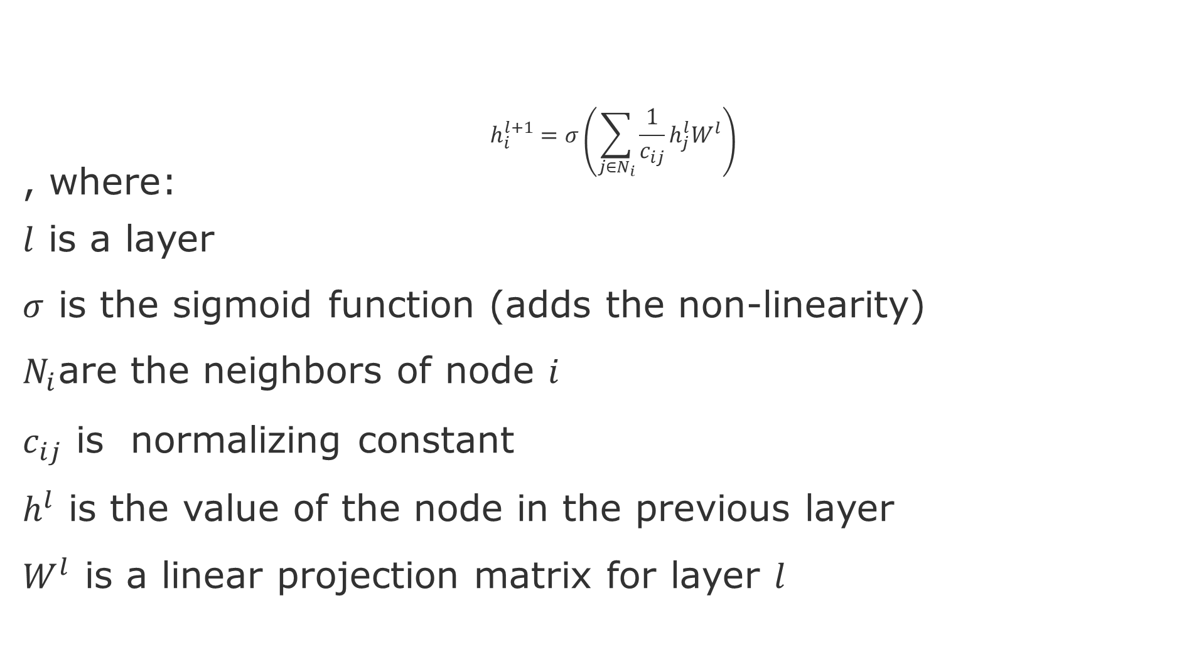
Relational GCN
$$h_{i}^{l+1}=σ\left(\sum_{j∈N_{i}}{\frac{1}{c_{ij}}h_{j}^{l}W^{l}}\right)$$
, where:
$l$ is a layer
$σ$ is the sigmoid function (adds the non-linearity)
$N_{i}$are the neighbors of node $i$
$c_{ij}$ is normalizing constant
$h^{l}$ is the value of the node in the previous layer
$W^{l}$ is a linear projection matrix for layer $l$

Slide 19
Graph Neural Networks - Essence
GNNs allow nodes to:
learn how to borrow feature information from nearby nodes (Feature Engineering)
have different computation graph that can also be learned (Embedding)
Main Challenge – Loss of Expressiveness
Graph Isomorphism – where the same computational graph leads to similar embeddings
Over-smoothing - where adding layers (hops) quickly causes the node embeddings to converge to similar vectors
Notes:
GNN essence - https://www.youtube.com/watch?v=WdtFKaRxTg4
Oversmoothing - https://towardsdatascience.com/over-smoothing-issue-in-graph-neural-network-bddc8fbc2472

Slide 20
Next steps
E
A
Z(E)
Logical Query
F
B
H
Z(G)
C
G
D
Graph data
Encoding
Embedding space
Reasoning
Graph query

Slide 21
Suggested Task: Over-smoothing mitigation solutions
Zhou, K., et al., 2020, Towards Deeper Graph Neural Networks with Differentiable Group Normalization, https://arxiv.org/abs/2006.06972
Chen, D., et al., 2019, Measuring and Relieving the Over-smoothing Problem for Graph Neural Networks from the Topological View, https://arxiv.org/abs/1909.03211
Oono, K., & Suzuki, T., 2021, Graph Neural Networks Exponentially Lose Expressive Power for Node Classification, https://arxiv.org/abs/1905.10947

Slide 22
Suggested Task: Anomaly detection in & with graphs
Rida, A., et al., 2021, Evaluation of Anomaly Detection for Cybersecurity Using Inductive Node Embedding with Convolutional Graph Neural Networks. In International Conference on Complex Networks and Their Applications (pp. 563-574). Springer.
Ma, Xiaoxiao, et al., 2021, A comprehensive survey on graph anomaly detection with deep learning. IEEE Transactions on Knowledge and Data Engineering
Wang, X.,et al., 2021, One-class graph neural networks for anomaly detection in attributed networks. Neural computing and applications, 33(18), 12073-12085.
Huang, Bin, et al., 2021, One-class Temporal Graph Attention Neural Network for Dynamic Graph Anomaly Detection. 2021 2nd International Conference on Electronics, Communications and Information Technology (CECIT). IEEE, 2021.
Notes:
Check papers that cite Wang, Daixin, et al. "A semi-supervised graph attentive network for financial fraud detection." 2019 IEEE International Conference on Data Mining (ICDM). IEEE, 2019.
https://scholar.google.com/scholar?hl=en&as_sdt=0%2C5&q=+semi-supervised+graph+attentive+network+for+financial+fraud+detecti&btnG=

Slide 23
Quick Math background based on Message Passing

Slide 24
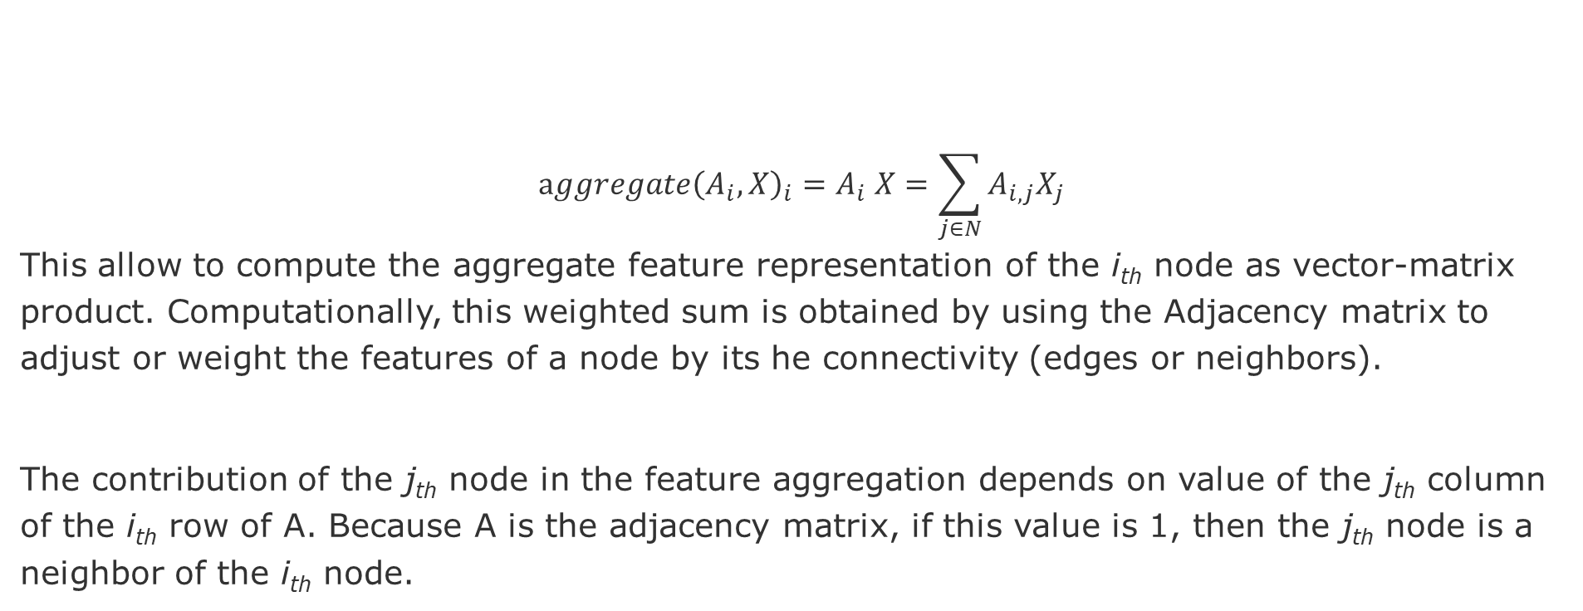
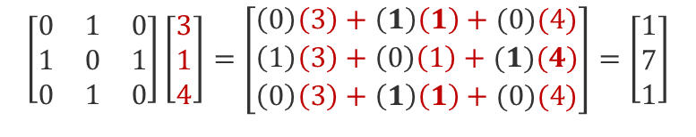
Sum Operation
$$aggregate{\left(A_{i},X\right)}_{i}=A_{i} X=\sum_{j∈N}{A_{i,j}X_{j}}$$
This allow to compute the aggregate feature representation of the i_{th} node as vector-matrix product. Computationally, this weighted sum is obtained by using the Adjacency matrix to adjust or weight the features of a node by its he connectivity (edges or neighbors).
The contribution of the j_{th} node in the feature aggregation depends on value of the j_{th} column of the i_{th} row of A. Because A is the adjacency matrix, if this value is 1, then the j_{th} node is a neighbor of the i_{th} node.
A
X
1
$$\left[\begin{matrix}0 & 1 & 0 \\ 1 & 0 & 1 \\ 0 & 1 & 0\end{matrix}\right]\left[\begin{aligned}3 \\ 1 \\ 4\end{aligned}\right]=\left[\begin{aligned}\left(0\right)\left(3\right)+\left(1\right)\left(1\right)+(0)(4) \\ \left(1\right)\left(3\right)+\left(0\right)\left(1\right)+(1)(4) \\ \left(0\right)\left(3\right)+\left(1\right)\left(1\right)+(0)(4)\end{aligned}\right]=\left[\begin{aligned}1 \\ 7 \\ 1\end{aligned}\right]$$
(4,1)
3
2
(3,1)
(1,7)
(node feature, aggregated feature)
Hence, the contribution of each neighbor depends only on the connectivity specified in the adjacency matrix A
Notes:
Nice explanations here:
https://towardsdatascience.com/how-to-do-deep-learning-on-graphs-with-graph-convolutional-networks-62acf5b143d0
Simple Message Passing on Graphs - https://www.youtube.com/watch?v=ijmxpItkRjc

Slide 25
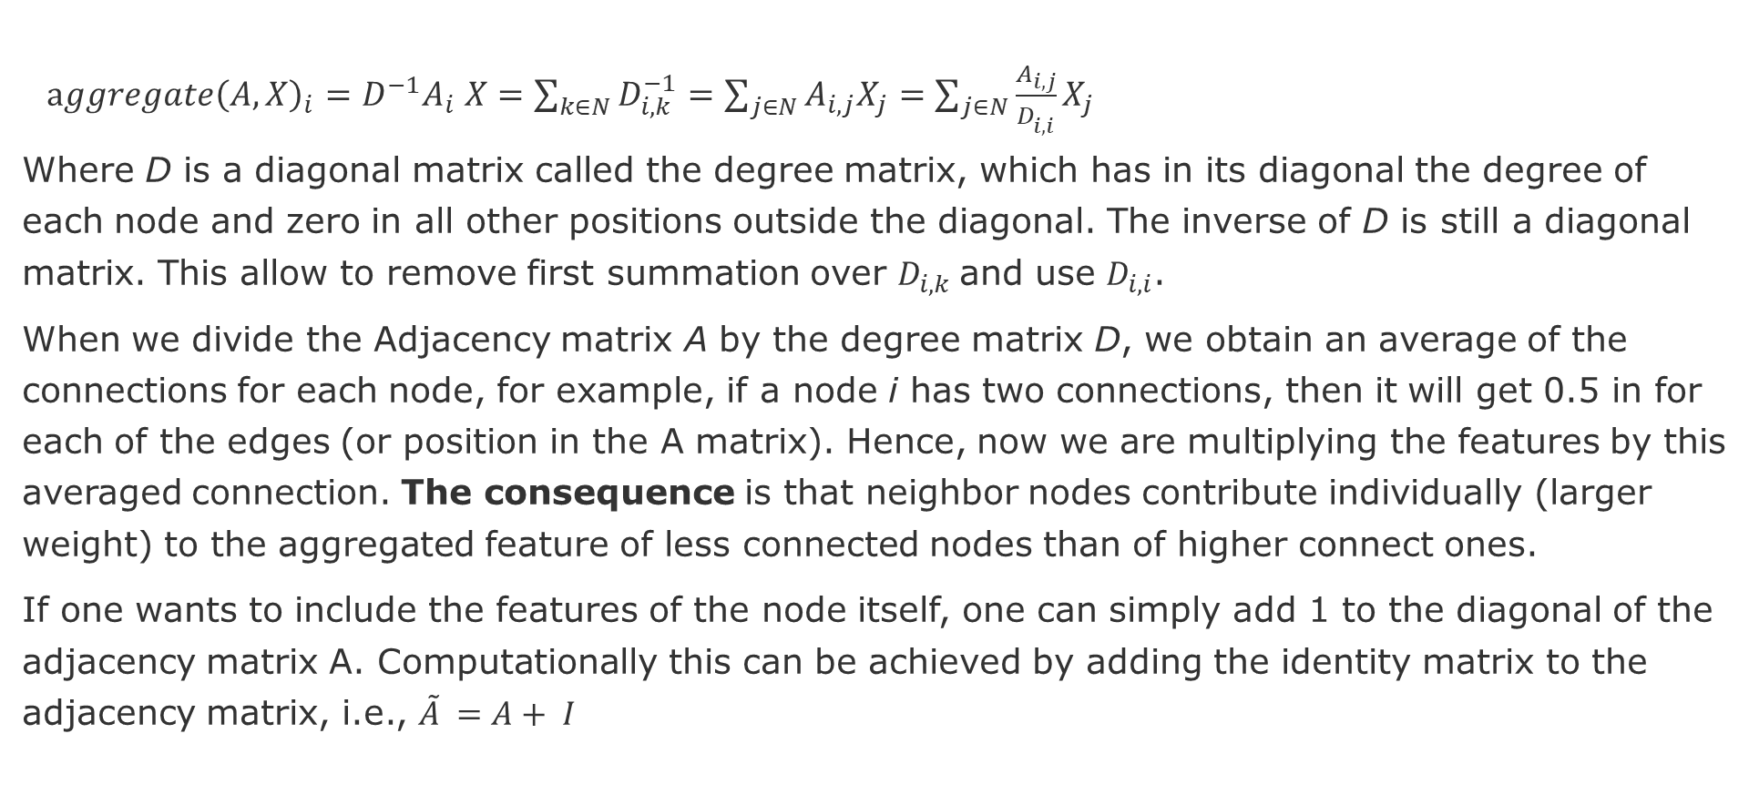
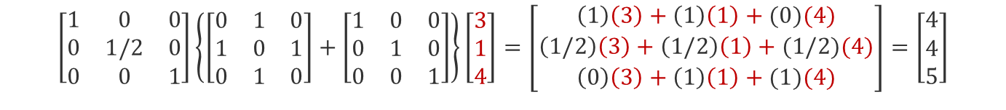
Average Operation
$aggregate{\left(A,X\right)}_{i}={D^{−1}A}_{i} X=\sum_{k∈N}{D_{i,k}^{−1}}=\sum_{j∈N}{A_{i,j}X_{j}}=\sum_{j∈N}{\frac{A_{i,j}}{D_{i,i}^{ }}X_{j}}$
Where D is a diagonal matrix called the degree matrix, which has in its diagonal the degree of each node and zero in all other positions outside the diagonal. The inverse of D is still a diagonal matrix. This allow to remove first summation over $D_{i,k}$and use $D_{i,i}$.
When we divide the Adjacency matrix A by the degree matrix D, we obtain an average of the connections for each node, for example, if a node i has two connections, then it will get 0.5 in for each of the edges (or position in the A matrix). Hence, now we are multiplying the features by this averaged connection. The consequence is that neighbor nodes contribute individually (larger weight) to the aggregated feature of less connected nodes than of higher connect ones.
If one wants to include the features of the node itself, one can simply add 1 to the diagonal of the adjacency matrix A. Computationally this can be achieved by adding the identity matrix to the adjacency matrix, i.e., ${\tilde{A}}_{ }=A+ I$
D⁻¹
A
I
X
(4,4)
1
3
$$\left[\begin{matrix}1 & 0 & 0 \\ 0 & 1/2 & 0 \\ 0 & 0 & 1\end{matrix}\right]\left\{\left[\begin{matrix}0 & 1 & 0 \\ 1 & 0 & 1 \\ 0 & 1 & 0\end{matrix}\right]+\left[\begin{matrix}1 & 0 & 0 \\ 0 & 1 & 0 \\ 0 & 0 & 1\end{matrix}\right]\right\}\left[\begin{aligned}3 \\ 1 \\ 4\end{aligned}\right]=\left[\begin{aligned}\left(1\right)\left(3\right)+\left(1\right)\left(1\right)+(0)(4) \\ \left(1/2\right)\left(3\right)+\left(1/2\right)\left(1\right)+(1/2)(4) \\ \left(0\right)\left(3\right)+\left(1\right)\left(1\right)+(1)(4)\end{aligned}\right]=\left[\begin{aligned}4 \\ 4 \\ 5\end{aligned}\right]$$
(3,5)
2
(node feature, aggregated feature)
(1,4)
Notes:
Nice explanations here:
https://towardsdatascience.com/how-to-do-deep-learning-on-graphs-with-graph-convolutional-networks-62acf5b143d0
Simple Message Passing on Graphs - https://www.youtube.com/watch?v=ijmxpItkRjc

Slide 26
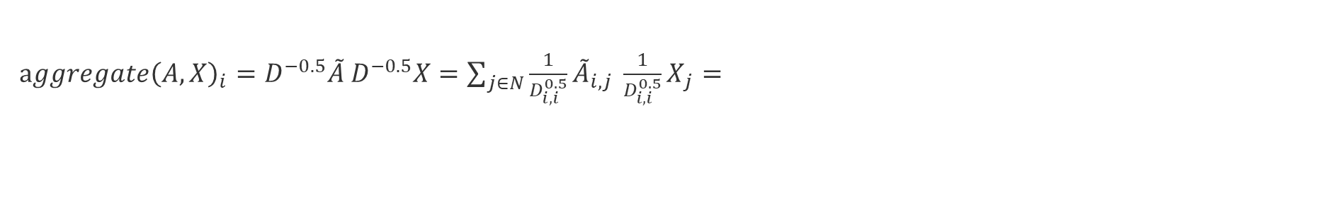
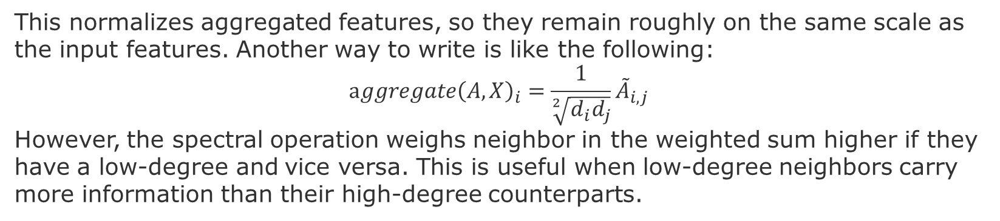
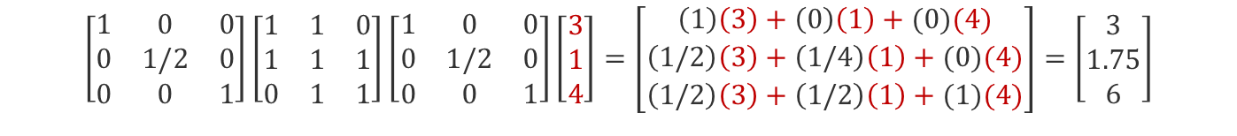
Spectral Operation
$aggregate{\left(A,X\right)}_{i}={D^{−0.5}\tilde{A}}_{ }D^{−0.5}X=\sum_{j∈N}{\frac{1}{D_{i,i}^{0.5}}{{\tilde{A}}_{i,j}}_{ }{\frac{1}{D_{i,i}^{0.5}}X}_{j}= }$
This normalizes aggregated features, so they remain roughly on the same scale as the input features. Another way to write is like the following:
$$aggregate{\left(A,X\right)}_{i}=\frac{1}{\sqrt[2]{d_{i}d_{j}}}{\tilde{A}}_{i,j}$$
However, the spectral operation weighs neighbor in the weighted sum higher if they have a low-degree and vice versa. This is useful when low-degree neighbors carry more information than their high-degree counterparts.
1
(3,3)
3
D^{-0.5}
Ã
D^{-0.5}
X
2
(4,6)
$$\left[\begin{matrix}1 & 0 & 0 \\ 0 & 1/2 & 0 \\ 0 & 0 & 1\end{matrix}\right]\left[\begin{matrix}1 & 1 & 0 \\ 1 & 1 & 1 \\ 0 & 1 & 1\end{matrix}\right]\left[\begin{matrix}1 & 0 & 0 \\ 0 & 1/2 & 0 \\ 0 & 0 & 1\end{matrix}\right]\left[\begin{aligned}3 \\ 1 \\ 4\end{aligned}\right]=\left[\begin{aligned}\left(1\right)\left(3\right)+\left(0\right)\left(1\right)+(0)(4) \\ \left(1/2\right)\left(3\right)+\left(1/4\right)\left(1\right)+(0)(4) \\ \left(1/2\right)\left(3\right)+\left(1/2\right)\left(1\right)+(1)(4)\end{aligned}\right]=\left[\begin{aligned}3 \\ 1.75 \\ 6\end{aligned}\right]$$
(node feature, aggregated feature)
(1,1.75)
Hence, the contribution of each neighbor depends only on the connectivity specified in the adjacency matrix A
Notes:
Nice explanations here:
https://towardsdatascience.com/how-to-do-deep-learning-on-graphs-with-graph-convolutional-networks-62acf5b143d0
Simple Message Passing on Graphs - https://www.youtube.com/watch?v=ijmxpItkRjc

Slide 27
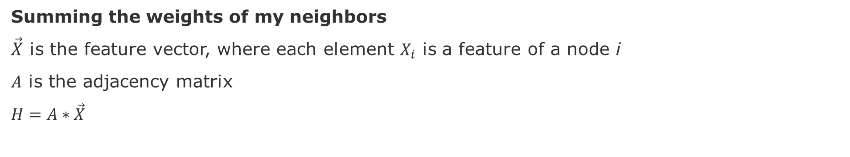
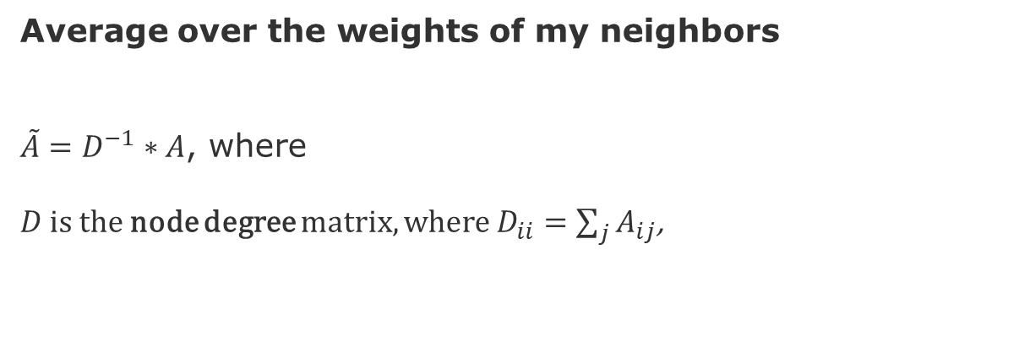
Message Passing with a Transition Matrix
Summing the weights of my neighbors
$\vec{X}$ is the feature vector, where each element $X_{i}$ is a feature of a node i
$A$ is the adjacency matrix
$H=A∗\vec{X}$
Average over the weights of my neighbors
$\tilde{A}=D^{−1}∗A$, where
$D$ is the node degree matrix, where $D_{ii}=\sum_{j}{A_{ij}}$,
Kipf, Thomas N., and Max Welling. (2017) "Semi-supervised classification with graph convolutional networks." ICRL, arXiv preprint arXiv:1609.02907
Notes:
Nice 10 min video here: https://www.youtube.com/watch?v=ijmxpItkRjc
Code here: https://github.com/tkipf/gcn

Slide 28
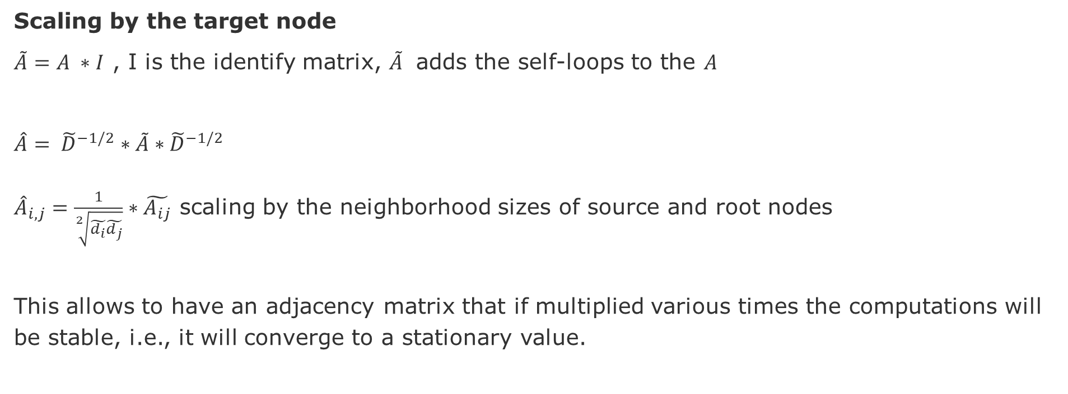
Message Passing – Scale by Target Node [Kipf & Welling 2017]
Scaling by the target node
$\tilde{A}=A ∗I$ , I is the identify matrix, $\tilde{A}$ adds the self-loops to the $A$
$\hat{A}= {\tilde{D}}^{−1/2}∗\tilde{A}∗{\tilde{D}}^{−1/2}$
${\hat{A}}_{i,j}=\frac{1}{\sqrt[2]{\tilde{d_{i}}\tilde{d_{j}}}}∗\tilde{A_{ij}}$ scaling by the neighborhood sizes of source and root nodes
This allows to have an adjacency matrix that if multiplied various times the computations will be stable, i.e., it will converge to a stationary value.
Kipf, Thomas N., and Max Welling. (2017) "Semi-supervised classification with graph convolutional networks." ICRL, arXiv preprint arXiv:1609.02907

Slide 29
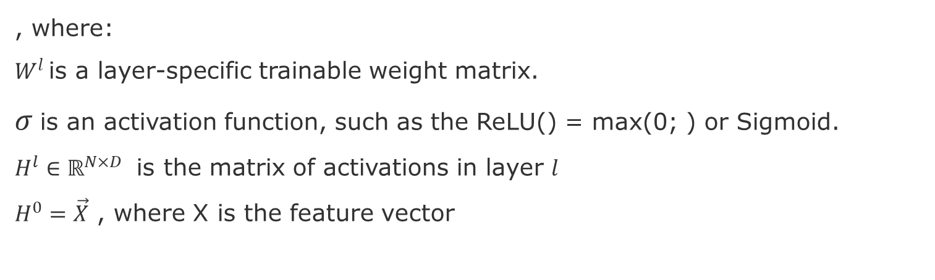
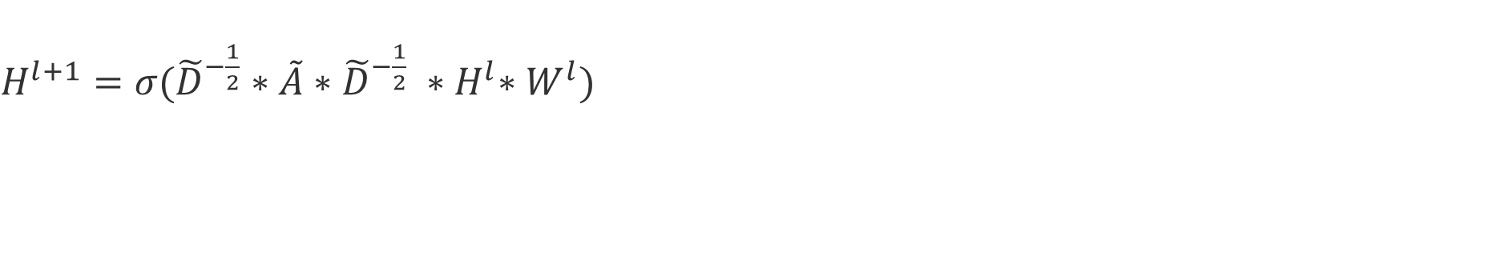
Fast Approximate Convolutions on Graphs [Kipf & Welling 2017]
$H^{l+1}=σ({\tilde{D}}^{−\frac{1}{2}}∗\tilde{A}∗{\tilde{D}}^{−\frac{1}{2}} {∗H}^{l}∗W^{l})$
, where:
$W^{l}$ is a layer-specific trainable weight matrix.
$σ$is an activation function, such as the ReLU() = max(0; ) or Sigmoid.
$H^{l}∈ℝ^{N×D}$ is the matrix of activations in layer $l$
$H^{0}=\vec{X}$ , where X is the feature vector
Kipf, Thomas N., and Max Welling. (2017) "Semi-supervised classification with graph convolutional networks." ICRL, arXiv preprint arXiv:1609.02907

Slide 30
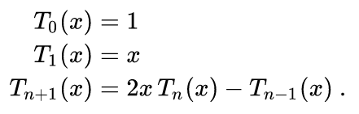
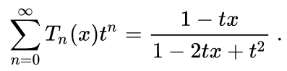
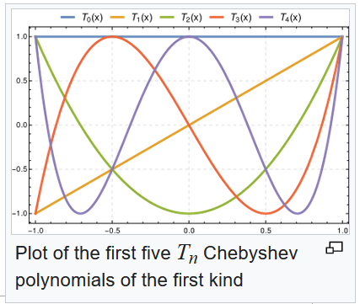
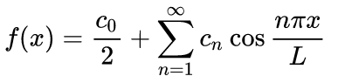
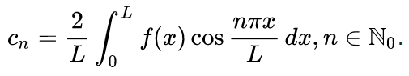
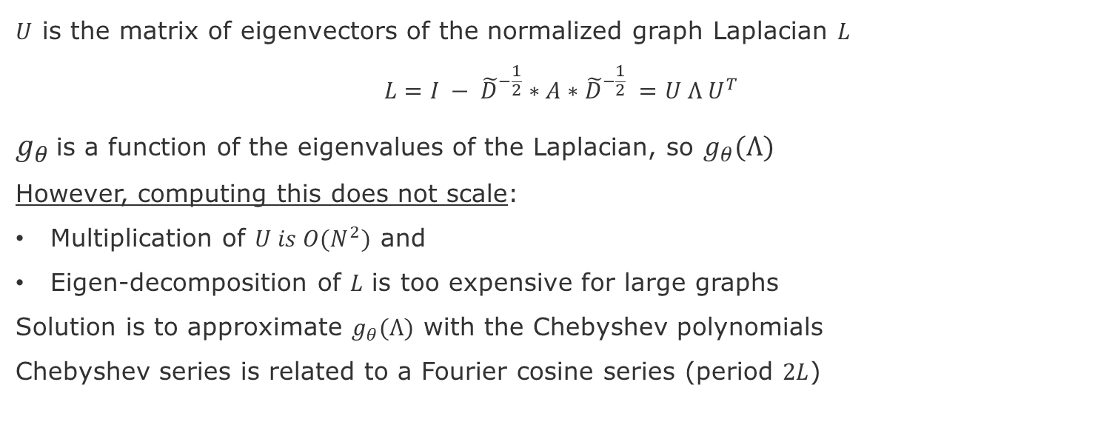
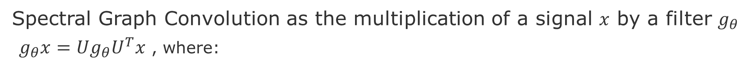
Spectral Graph Convolutions [Kipf & Welling 2017]
Spectral Graph Convolution as the multiplication of a signal $x$ by a filter $g_{θ}$
$g_{θ}x=Ug_{θ}U^{T}x$ , where:
$U$ is the matrix of eigenvectors of the normalized graph Laplacian $L$
$${L=I − \tilde{D}}^{−\frac{1}{2}}∗A∗{\tilde{D}}^{−\frac{1}{2}} =U Λ U^{T}$$
$g_{θ}$is a function of the eigenvalues of the Laplacian, so $g_{θ}(Λ)$
However, computing this does not scale:
Multiplication of $U is O(N^{2})$ and
Eigen-decomposition of $L$ is too expensive for large graphs
Solution is to approximate $g_{θ}(Λ)$ with the Chebyshev polynomials
Chebyshev series is related to a Fourier cosine series (period $2L$)
Wikipedia
source: Kipf, T. N. & Welling, M., "Semi-supervised classification with graph convolutional networks." ICRL, 2017

Slide 31
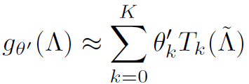
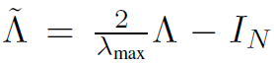
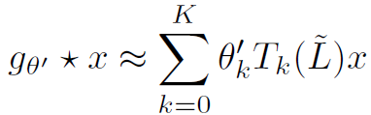
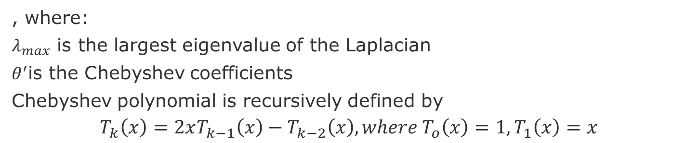
Approximation with Chebyshev Polynomials [Hammond 2011]
, where:
$λ_{max}$ is the largest eigenvalue of the Laplacian
$θ^{′}$is the Chebyshev coefficients
Chebyshev polynomial is recursively defined by
$$T_{k}\left(x\right)=2xT_{k−1}\left(x\right)−T_{k−2}\left(x\right), where T_{o}\left(x\right)=1, T_{1}\left(x\right)=x$$
Hammond, D. et al., (2011) Wavelets on graphs via spectral graph theory. Applied and Computational Harmonic Analysis, 30(2):129–150

Slide 32
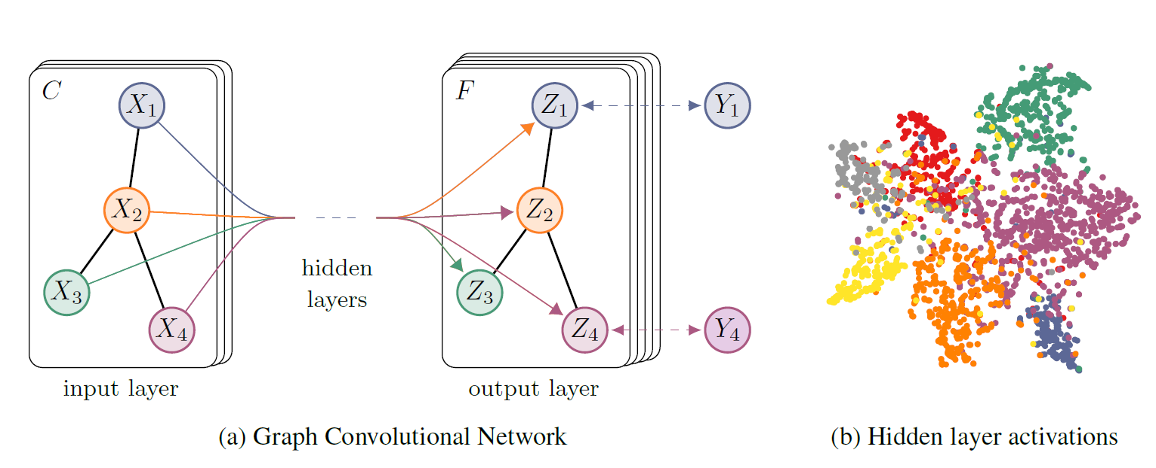
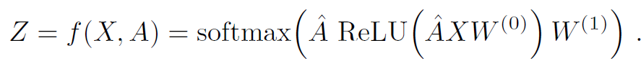
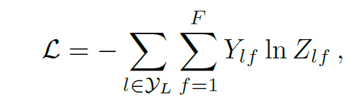
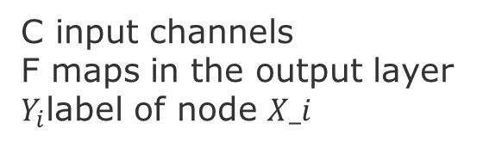
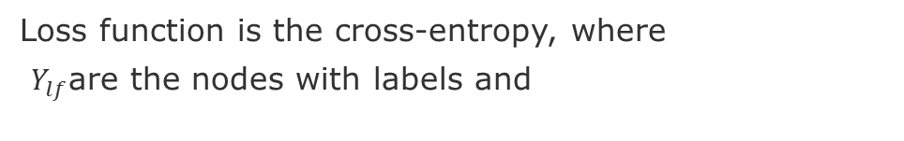
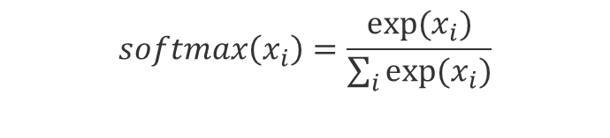
Forward computation in the GNN [Kipf & Welling 2017]
C input channels
F maps in the output layer
$Y_{i}$label of node $X_i$
$$softmax\left(x_{i}\right)=\frac{exp⁡(x_{i})}{\sum_{i}{exp⁡(x_{i})}}$$
Loss function is the cross-entropy, where
$Y_{lf}$are the nodes with labels and
Kipf, Thomas N., and Max Welling. (2017) "Semi-supervised classification with graph convolutional networks." ICRL, arXiv preprint arXiv:1609.02907
Code to reproduce:https://github.com/tkipf/gcn

Slide 33







Softmax [1]
where, $x∈ℝ$features and $θ$parameters to optimize
where, $y$are the classes of$x$
Cost function $J$
Gradient of $J$
[1] http://ufldl.stanford.edu/tutorial/supervised/SoftmaxRegression/

Slide 34
Next and Future Tasks
Compute and compare graph metrics (Wednesday, 2.12)
Any metrics and networks of your choice
First draft of abstract (Friday, 4.12)
Predictions using traditional method (Wednesday, 9.12)
Any two methods of your choice
Related work draft (Friday, 11.12)
Node and Graph Feature Learning (Wednesday, 16.12)
Any two methods of your choice
Design alternative pipelines for your GNN (Wednesday, 06.01)
Three alternative different options for embedding, aggregation, and enconding
Test at least one.

Slide 35
Task - Message Passing – Simulation
Execute and Prepare to Explain the following simulation
Create a graph that reflects SockShop ServiceMash diagram
Simulate message passing from a central node
Simulate message passing from a intermediate node
Source code model from [Zak Jost]: https://github.com/christianadriano/blog_code/blob/master/gcn_numpy/message_passing.ipynb
Zak Jost, zjost/blog_code, http://blog.zakjost.com/

Slide 36
END

